Slide 1

LEADING WITHOUT FORMAL AUTHORITY
BY: JOYAL JOHNSON
SREEHARI JEEVAN

Slide 2
Contents
Develop a leadership mind.
Leadership Languages and Behaviors
High-Stakes Situations
Influence that Leads

Slide 3

Develop a leadership mindset
Why develop a leadership mindset
Impact on performance
More engagement and support
Find opportunities to lead
Mentoring
Find a mentor
Be a mentor
Develop your leadership style.

Slide 4
Develop a leadership mindset
Navigating the organizational hierarchy
Up the hierarchy
Speak at a strategical level
Down the hierarchy
Speak at a tactical level

Slide 5
Leadership Languages and Behaviors
Add value in meetings
Agenda and time frame
End the meeting positively
Mindful listening
Help notice things you missed before
Help sort and frame information
Inspire others

Slide 6
Leadership Languages and Behaviors
Adapt to change
Show enthusiasm
Don’t ignore the challenges
Don't be openly negative
Setting expectations vs giving orders
Be crystal clear
Connect expectations to outcome
Don't be late
Give feedbacks

Slide 7
High-Stakes Situations
To tattle or to not tattle
Lead through challenges
Identify potential challenges
Keep the team mindset alive
When your boss messes up
Public
Private
Ask for help

Slide 8
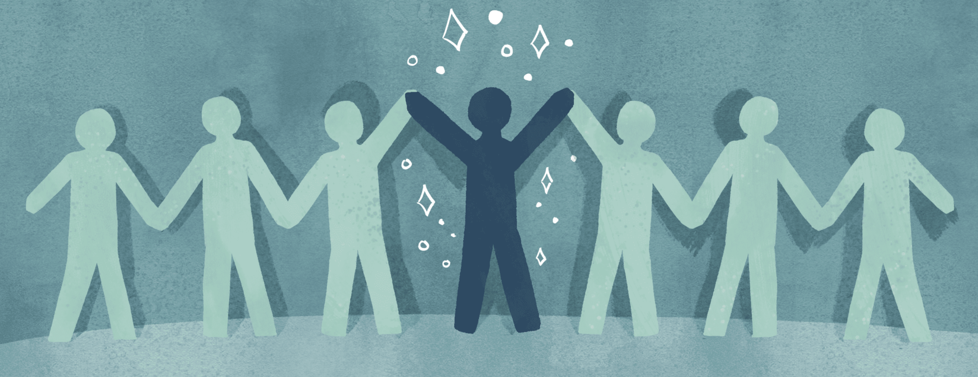
Influence That Lasts
Shape a culture of collaboration
Create a safe space
Foster trust and respect
Continually learning
Focus on softs skills and hard skills
Hands on learning
Influencing in difficult times
Build trust

Slide 9
THANK YOU

